Slide 1
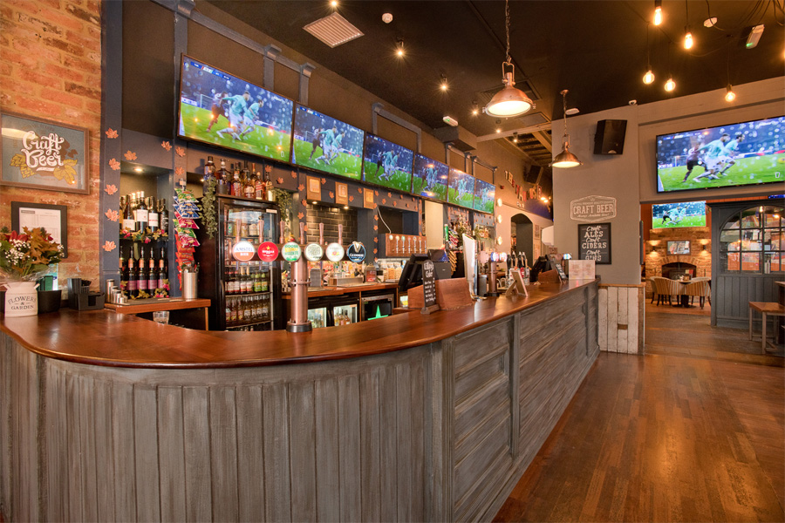
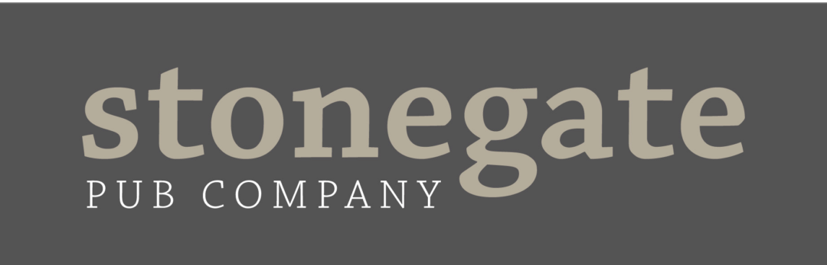
Interview Assessment
Web-scrape & analysis of Marston’s beverage data
04/07/2024

Slide 2
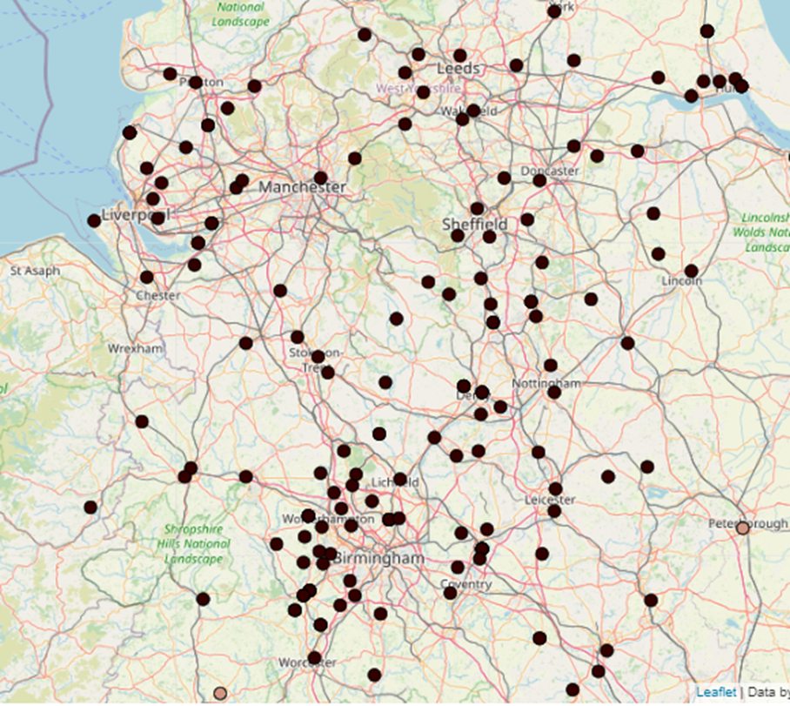
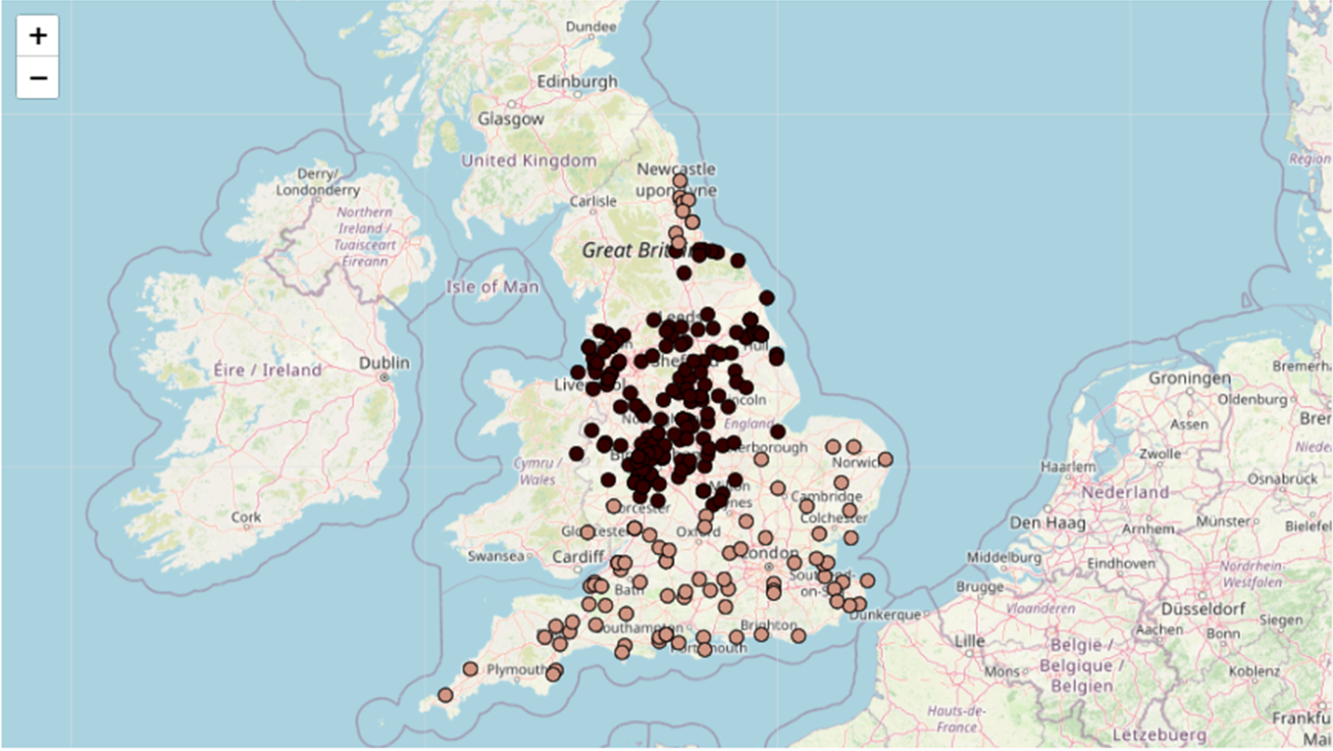

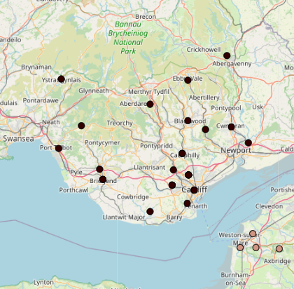
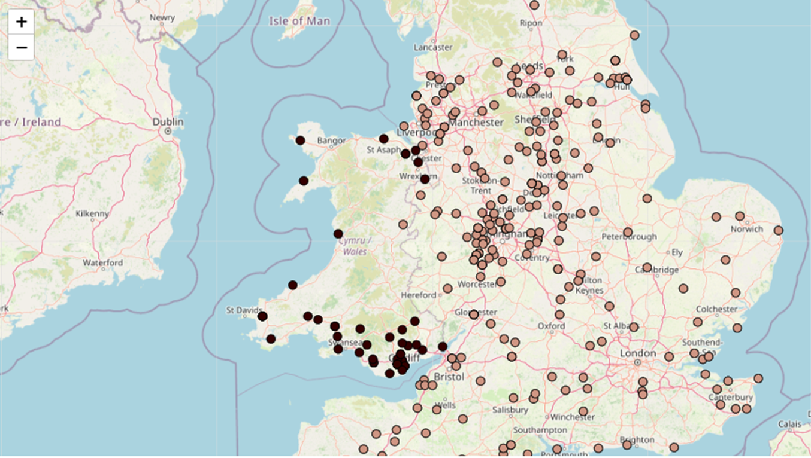

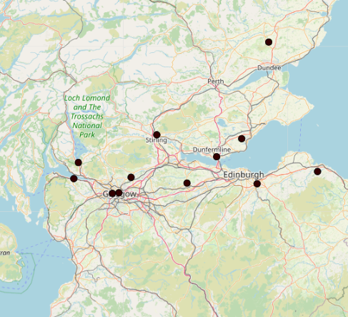
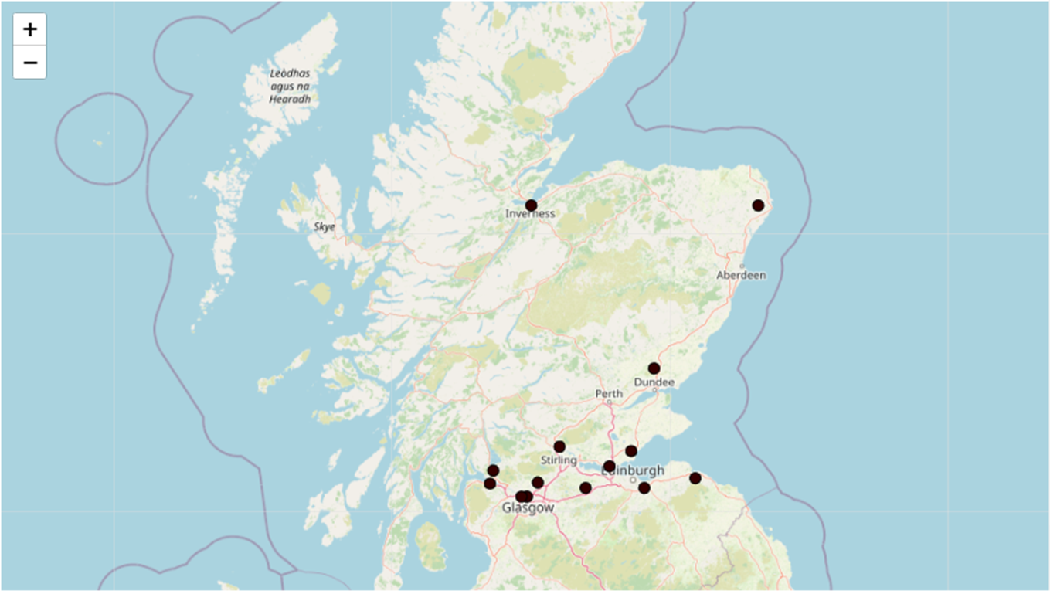

Exploratory Data Analysis & Findings
Distribution of Marston’s UK Pubs
Data scraped from 314 pubs across the UK – from Inverness to Cornwall
4 in 5 pubs located in England
Just 14 pubs in Scotland
As of June-24 zero pubs located in Northern Ireland
By Country
England
43% of pubs in the Midlands (1 in 4 WM)
2 pubs in London – higher rent, staff wages, utility costs, sheer amount of competition
Higher concentration of pubs situated within city radius.
Wales
64% of pubs in the South – particularly dense near Cardiff and Newport
Welsh pubs tend to hug the coastal line
Scotland
11 of 14 pubs in the South – almost all situated within city radius
0 pubs located in Edinburgh, but 2 in Glasgow

Slide 3
Exploratory Data Analysis & Findings
Beverage Menu Analysis
~115k beverage products across 314 pubs (avg. of 366 products per pub)
1,738 unique products across 7 categories (Draughts, Spirits, Bottles, Wine, Cocktails, Hot Beverages, Soft Beverages)
Draught
Ales have the highest no. of unique products at 41 – almost double second-placed type; Beers with 24. Ales also cheapest draught type by 14%, with avg. pint price just £4.64. Premium brands inc. Hobgoblin IPA, 61 Deep
Cider have more options in the SW (11) and Wales (10) vs rest of UK avg. (6). SW known for ‘Cider-drinkers’. Premium brands inc. Rosie Pig, Old Mout.
Beer typically most expensive, avg. pint price at £5.46 with std of 80p. Premium brands inc. Erdinger, Neck Oil, Estrella.
Marston’s only serve 1 Stout product – Guinness.
NE has cheapest avg. pint price across the four draught types, with SE being most expensive (except Stout -> London, low sample-size). SW also expensive, particularly for Cider – possible surge pricing based on demand.
Spirits
Gin have the highest no. of unique products at 50 – significantly larger than the likes of Brandy and Vodka who have 4 and 14, respectively.
Pricing generally consistent across the spirit types for single measure, however, Shots & Bombs tend to be slightly cheaper – likely priced to encourage upsell/multibuy through offers such as ‘3 J-bombs for £6’, ‘BOGOF on Shots’
As with Draughts, NE and Scotland tend to be cheapest areas for spirits (regardless of type of spirit). London is the most expensive (however, sample = 2 pubs).
As expected, cheapest products typically 0.0% alc or Schnapps. Premium brands by type > Gin – Independent Producers, Warner Edwards | Vodka – GG, Chase | Whisky – Gentleman Jack, Lagavulin | Brandy – Remy Martin (just) | Rum – Appleton Signature, Dead Man’s Spiced
Bottles
Mirroring draughts, Ales have the most variation amongst bottle types, with 56 unique products – exactly double second-placed type; Beers, with 28. Alcopops have the least no. of unique products – perhaps due to low sales volume or tight profit margins (maybe even a loss-leader?).
Despite being second cheapest draught, Cider is on average the most expensive bottle type at £5.71. As expected, low & no alcohol bottles are the cheapest option (by ~50p). Like draughts, Ales are on average the cheapest alcoholic choice.
Excl. London, Wales have on average the most expensive products for all bottle types except Ales (SW). Akin with results observed elsewhere, NE tends to on average the cheapest products.
Wine
Mirroring
Cocktails
Hot Beverages
Soft Beverages

Slide 5
Stonegate Focus and Recommendations
Most pubs located in England, with almost half in the Midlands. Pub location typically chosen within major city radi. Welsh pubs hugging coastline. Recommendation: analyse Stonegate sales/rev by region in England, with a focus on those within city radi vs those not – do city-based pubs yield higher profit?
w.r.t Regions, prices tend to align with distribution of wealth and local economy. The more north you go, the cheaper beverages become (on avg.). Recommendation: Set regional pricing of products to align with local wealth and economy. Periodically review regional prices vs rivals to gain/retain competitive-edge.
Evidence of surge pricing for specific product types in specific regions – need additional data and statistical tests to confirm

Slide 6
Analysis Limitations & Future Enhancement
How would you scale up your analysis to capture prices for other pub competitors across the UK? What we used to do was some local observations of pricing data – visiting a sample of establishments and recording data – can be time-consuming, especially if you want to do this periodically. A competitor but not a pub is supermarkets – perhaps an opportunity to webscrape section of their websites. External research and data – for example The Pub Beer Price Index has information on cheapest/average price of a pint by region and type of establishment, RPI (Retail Price Index) also contains information on national statistics relating to inflation of product pruces
How could you use data from Stonegate to make your dataset more powerful? Superimpose Stonegate site list onto geographic map to observe dispersion of sites across the UK, also compare average product/category price by area. Use MiXR app to analyse customer buying habits, popular bverages in specific areas of UK, what isn’t popular – and prhaps could be discontinued. Feedback/Survey on MiXR app with small value giveaway to get consumer opinions on pricing
What would you do next to develop and validate your recommendations? i.e. whatever I recommend to stonegate, how would I actually carry that out – A/B testing? Surveying areas where our prices are deemed low/high to gather consumer opinion on our prices – if found price is deemed low in an area, potentially carry out A/B test on two pubs in that area, putting price up in one and not the other and seeing how that affects revenue/sales volume
Inconsistency between sub-category of IPAs
Hypothesised that SW are cider drinkers with current data supporting this – would need to collect sales data by region and observe % differences for SW Cider sales vs other regions, also carry out statistical significance testing to assimilate whether differences observed are likely to chance or not
Look at drink pricing in city centres vs suburbs – how do they vary?
Capture Marston’s data periodically with datestamps to observe any trends, seasonality, or external events that influence their prices – for example, are average prices higher during major sports tournaments.

Slide 7
APPENDIX

Slide 8
Task Challenges and Notes
Much variation in pub menu layout and categorisation of products. Best approach was to scrape everything, filter out non-relevant data, and re-map product hierarchy, as opposed to customising code per pub.
Portions of the code is sub-optimal and requires refactoring to improve performance – current scraper has time complexity O(n³).
Some pub menus un-scrapeable (for example, ‘Pub menu not available at this time.’). These were dealt with using generic code (skipping the pub).
Jupyter Notebook used, relying on local compute power (adequate for this task). Performance improvement can be observed using GPUs or Cloud Services (such as Google Colab or AWS).
Would typically use Excel for Pivot Table analysis but acknowledge part of the assessment purpose is to demonstrate coding competence. Python hard-coded and interactive pivots used instead.
Presentation restricted to findings summary, recommendations, and future enhancement. All analysis work has been detailed in the Jupyter Notebook.

